Slide 1
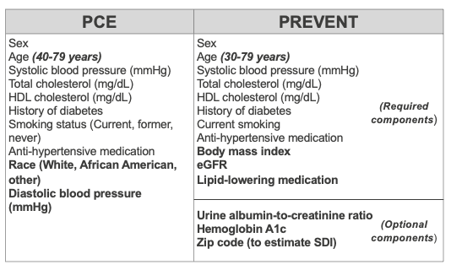
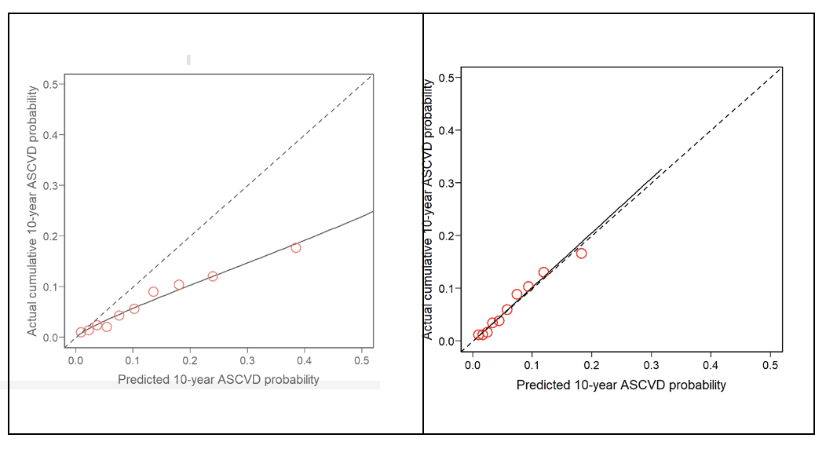
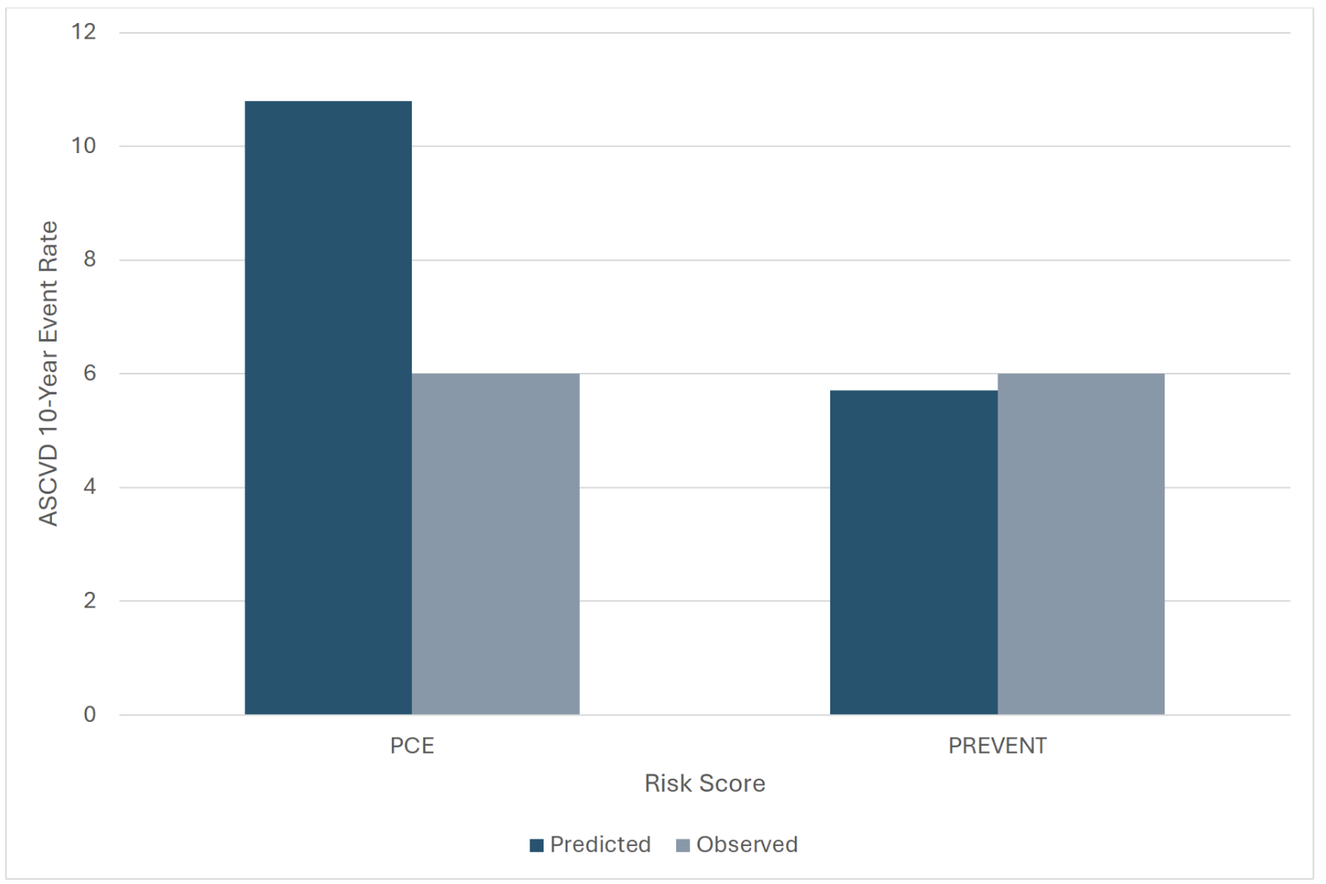
The comparative performance of the PREVENT risk calculator vs the Pooled Cohort Equations in a diverse, multi-ethnic cohort: The Multi-Ethnic Study of Atherosclerosis (MESA)
M. Sims Hershey MD/MBA, Brittany Saldivar murphy MD, Yunbi Nam MS, Wendy post MD, Robyn mclelland pHD, Shi huang phd, Andrew Defilippis mD
INTRODUCTION
METHODS
The Pooled Cohort Equations (PCE) developed by the American College of Cardiology (ACC) and American Heart Association (AHA) were developed in 2013 to estimate 10-year risk of development of ASCVD. It has been the guideline-recommended strategy for risk stratification clinically.
PCE has been shown to have poor predictive value in modern, diverse populations, and includes race as a risk factor, which has been shown to be non-contributory to the risk prediction models in some cases.
In 2023, the AHA developed the PREVENT equations (AHA Predicting Risk of CVD Events) in an effort to improve and optimize risk prediction.
We aimed to assess the comparative performance of the new PREVENT risk score versus the current guideline recommended PCE in a modern, diverse cohort (MESA).
6098 individuals who self-identified as White, Black, Hispanic and Chinese from the Multi-Ethnic Study of Atherosclerosis (MESA) were included in the analysis.
Baseline predicted event rates from enrollment were calculated using the PCE and PREVENT-ASCVD equations.
Discordance between observed and expected rates were calculated.
ASCVD events were defined as coronary artery disease, including myocardial infarction and fatal coronary disease, and stroke.
Harrell’s C index was used to evaluate discrimination.
Calibration was evaluated comparing Kaplan-Meier estimated 10-year event rates to predicted event rates to calculate mean absolute error (MAE).
Table 1. Risk factors included in the calculation of the PCE and PREVENT risk scores. Variables differing in quality or inclusion between the two scores are highlighted in bold.
RESULTS
The observed event rate (6%) was more similar to the predicted PREVENT event rate (5.7%) compared to the PCE (10.8%).
42% of this cohort would be re-classified to a lower ASCVD risk category using the PREVENT equation versus the PCE.
Table 3: Number of individuals in each risk category defined as low risk (<5% risk of ASCVD event in 10 years), borderline risk (5-7.5%), intermediate risk (7.5% - <20%), and high risk (>20%) according to the PCE and re-classified by PREVENT equations.
Table 2: 10-year ASCVD event rates as predicted by the PCE and PREVENT equations and observed events in the Multi-Ethnic Study of Atherosclerosis (MESA)
a. Discordance is defined as [(predicted % - observed %)/observed %) x 100].
Figure 2: Calibration of 10-year predicted ASCVD risk with the PCE (panel A) and the PREVENT-ASCVD (panel B) equation compared to observed event rate displayed as deciles of predicted risk. The dotted line represents a perfectly calibrated model and the solid line represents the calibration of our models within MESA..
Conclusion
New diagnostic tools should be evaluated against current practice standards before adoption into clinical practice.
In this modern, multi-ethnic cohort, the PREVENT equations portend a more accurate risk prediction stratification than the current guideline-recommended PCE.
These findings support adoption of this updated prediction tool.
Figure 1: 10-year ASCVD event rates as predicted by the PCE and PREVENT-ASCVD equations and observed events in the Multi-Ethnic Study of Atherosclerosis (MESA)
Table 2: 10-year ASCVD event rates as predicted by the PCE and PREVENT equations and observed events in the Multi-Ethnic Study of Atherosclerosis (MESA)
a. Discordance is defined as [(predicted % - observed %)/observed %) x 100].
Risk Score | Number | Predicted Events | Observed Events | Absolute Difference | Discordance (%)ª | C-statistic | Mean absolute error (MAE)
PCE | 6098 | 658 (10.8%) | 366 (6%) | 4.8 | 79.8 | 0.73 | 0.058
PREVENT ASCVD | 6098 | 346 (5.7%) | 366 (6%) | -0.3 | -5.5 | 0.73 | 0.001

