Slide 1
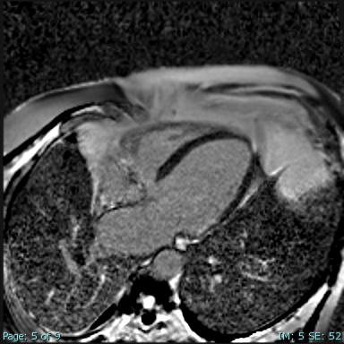
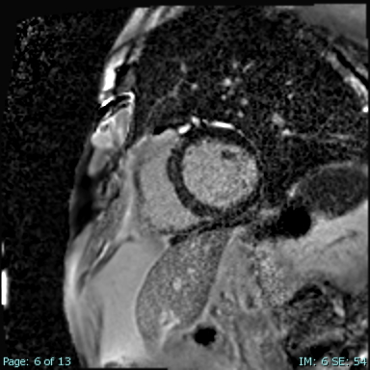
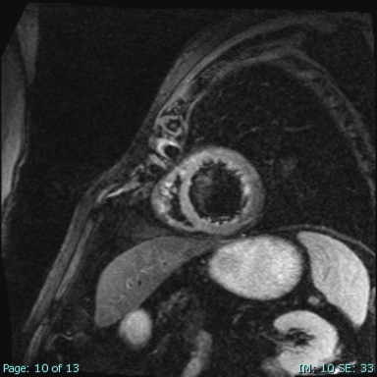
Atezolizumab Induced Myocarditis
Aladen Amro, DO, Shawna Stephens, DO, Nikhil Jain, MD, Raj Baljepally, MD
University of Tennessee Graduate School of Medicine and UT Medical Center, Knoxville, TN
Introduction
Imaging
Management
Immunotherapy has been increasingly utilized in treating various cancers, yet it carries the risk of immune-related adverse effects (including myocarditis).
We present a case of immunotherapy-induced myocarditis caused by Atezolizumab in a patient with a history of bioprosthetic aortic valve replacement.
High dose steroids (methylprednisolone 1 g) for 5 days followed by prednisone taper, diuretics, and heart failure treatment with metoprolol succinate, lisinopril, and spironolactone.
SGLT-2 not initiated due to concern for infection in setting of high dose steroids.
Life vest given reduced ejection fraction and frequent ventricular ectopy.
Case Presentation
74 year old male with prior bioprosthetic Aortic valve replacement and normal left ventricular function developed squamous cell carcinoma of the lung. He was treated with right upper lobe lobectomy followed by carboplatin/paclitaxel chemotherapy and more recently was started on Atezolizumab immunotherapy. He presented with progressive shortness of breath, elevated troponins, elevated ESR and CRP, and frequent PVCs on telemetry.
Echo revealed a mildly dilated LV with moderately reduced EF of 30-35% and no evidence of bioprosthetic aortic valve stenosis.
Coronary angiogram revealed nonobstructive disease.
Given symptoms began shortly following initiation of Atezolizumab there was high suspicion for check-point inhibitor (CPI) related myocarditis.
Cardiac MRI revealed a moderately dilated LV with severe global systolic dysfunction with EF of <20% and linear mid myocardial LGE in the basal, lateral, and anterolateral walls consistent with a diagnosis of grade 3 immune CPI related myocarditis.
Discussion
CPI related myocarditis can rarely develop or deteriorate both in patients with and without prior cardiac history.
Observational studies have suggested that the incidence of myocarditis is higher in patients with combination immunotherapy.
Atezolizumab, a monoclonal antibody, inhibits PD-L1 and activates tumor-specific T cells.
Although CPI related myocarditis has been reported, it is extremely uncommon with Atezolizumab therapy.
Only one other case has been reported in the literature, to our knowledge.
Prompt recognition and aggressive management with steroids and supportive therapies are crucial.
Additional immunosuppressive agents (mycophenolate) may be used in addition to steroids in life threatening cases.
LGE 4 Chamber
LGE Short Axis
References
Sessums M, et al. Atezolizumab-induced myositis and myocarditis in a patient with metastatic urothelial carcinoma. BMJ Case Rep. 2020 Dec 9;13(12):e236357. doi: 10.1136/bcr-2020-236357. PMID: 33298477; PMCID: PMC7733070.
STIR Short Axis
STIR Short Axis

