Slide 1


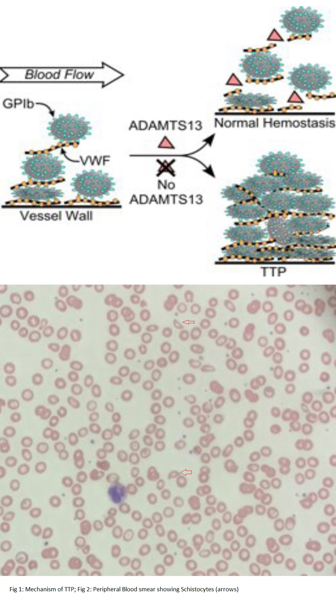

TACROLIMUS-INDUCED THROMBOTIC THROMBOCYTOPENIC PURPURA (TTP) IN A HEART TRANSPLANT PATIENT
Roshan Bista, MD, Manasa Jasti, MD, Mohamed Zghouzi, MD, Jessi Elrod, NP, John B. Biglane, MD
UTHSC-Nashville Cardiology Fellowship Program
Background
Differential Diagnosis:
Sepsis
Hemolytic Uremic Syndrome (HUS)
Heparin-Induced Thrombocytopenia
Thrombotic Thrombocytopenic Purpura (TTP)
Discussion and Conclusion:
In conclusion, vigilant monitoring and early recognition of rare complications such as tacrolimus-induced TTP are essential in post-transplant care. This case highlights the importance of considering TTP in the differential diagnosis of thrombocytopenia, especially when clinical and laboratory findings align with this life-threatening condition. Prompt intervention and multidisciplinary care are crucial for the optimal management of such cases.
Tacrolimus is a widely used immunosuppressive medication in heart transplant recipients that inhibits calcineurin. Thrombotic thrombocytopenic purpura (TTP) is a rare but severe hematological disorder characterized by microangiopathic hemolytic anemia, thrombocytopenia, renal dysfunction, neurological symptoms, and fever. The incidence of drug-induced TTP (Thrombotic Thrombocytopenic purpura) is between 10 % and 13% of all TTP cases. The incidence of tacrolimus-induced TTP is about 1% to 4.7%, with the highest incidence in post-transplant patients [1]. There are only rare case reports of tacrolimus-induced TTP in post-heart transplant patients [2]
Case Presentation
The patient, a 64-year-old female with a complex medical history including end-stage heart failure, underwent heart transplantation after a series of complications following HeartMate-3 LVAD implantation two years ago, including a pseudomonal driveline infection, cerebrovascular accident (CVA), chronic kidney disease (CKD), and pulmonary hypertension. Tacrolimus was introduced as part of her immunosuppressive regimen, but its administration was initially delayed due to renal insufficiency.
On postoperative day 4, tacrolimus administration commenced but was temporarily halted on day 4 due to deteriorating renal function, resuming on day 6 after continuous renal replacement therapy (CRRT) initiation. The patient also developed sepsis secondary to pneumonia, necessitating broad-spectrum antibiotics on day 8. Her clinical course was further complicated by difficulty weaning off mechanical ventilation due to delirium and fever on day 9.
Physical examination revealed a febrile, confused patient with mild generalized edema and respiratory distress.
References:
[1]https://www.ncbi.nlm.nih.gov/pmc/articles/PMC9275527/#:~:text=DITMA%20associated%20with%20tacrolimus%20has,induce%20TMA%20is%20not%20clear.
[2] Gill R, Meghrajani V. Tacrolimus-Induced Thrombotic Thrombocytopenic Purpura (TTP) in a Post-Heart Transplant Patient: A Case Report. Cureus. 2022 Jun 12;14(6):e25874. doi: 10.7759/cureus.25874. eCollection 2022 Jun.
[3]J. Evan Sadler; Von Willebrand factor, ADAMTS13, and thrombotic thrombocytopenic purpura. Blood 2008; 112 (1): 11–18. doi: https://doi.org/10.1182/blood-2008-02-078170
Post op day/Labs | WBC in K | Hemoglobin | Platelet in K | Cr
1. | 10.5 | 8.8 | 37 | 2.3
4. | 25.4 | 9.4 | 63 | 3.5
6. | 25.5 | 9.6 | 70 | 5.9
8. | 24.1 | 5.8 | 23 | 1.9
18 (after completion of 5th Plasma Exchange) | 13.3 | 7.1 | 110 | 3.3
87 | 8.8 | 9.5 | 418 | 1.4

